Slide 1





Add company name here | MM/DD/YYYY
PROJECT BRIEF DECK
name of project:
Category Classification & Missing Value Estimation
presented by:
Maja Kadic

Slide 2
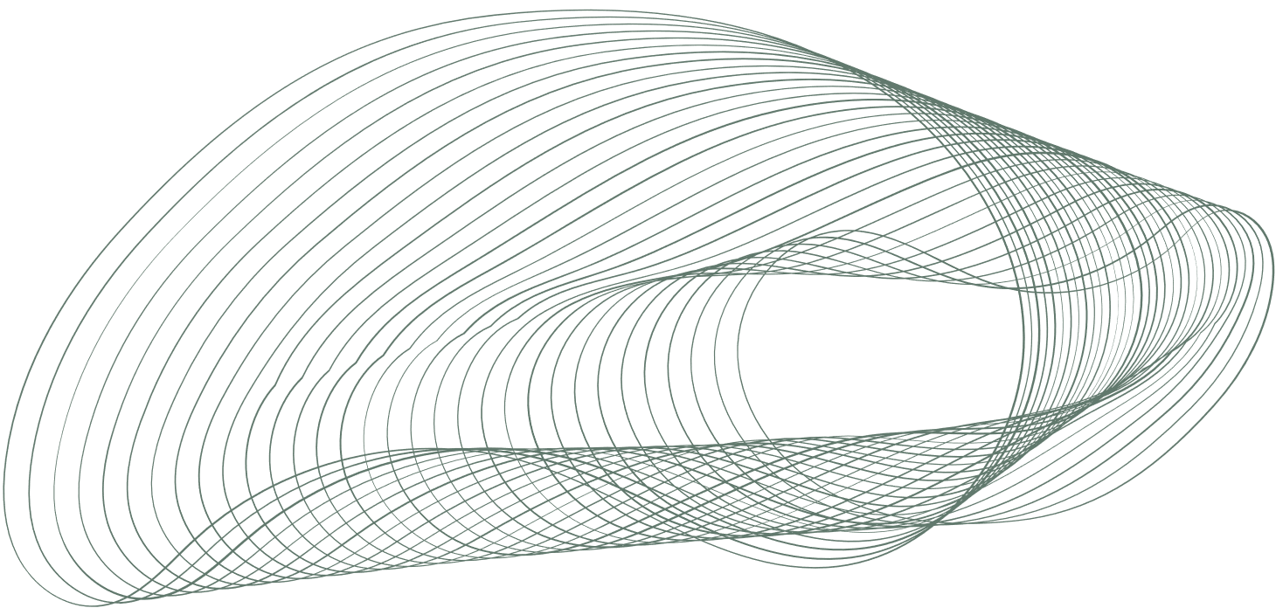


03 Overview
04 Dataset
05 Methodology
Agenda
06 Expected Outcomes
07 Timeline and Next Steps
08 References

Slide 3




Overview
Project aims to apply machine learning principles for classification and estimating missing values in datasets
Objective
Methodology
Expected Outcomes
Applying machine learning concepts for classification in diverse datasets and for accurately estimating missing values
Tailoring machine learning models to each dataset’s specifics, and using statistical methods for precise imputation of missing values
Improved accuracy in classification, effective handling of high-dimensional data, and reliable imputation of missing values in gene expression and viral datasets

Slide 4










Dataset
Classification Datasets: collections of data points, each labeled with a class category, used to train and evaluate machine learning models that predict the category of new, unseen data based on learned patterns
Dataset 1
Dataset 2
Dataset 3
Dataset 4
Dataset 5
Complex, 3312 features
150 training samples
Test set has 53 samples, spanning 5 classes
Complex, 9182 features
100 training samples, with a broader range of 11 classes
Test set has 74 samples
Lower dimensionality, 13 features, 9 classes
6300 training samples
Test set has 2693 samples
112 features
Training dataset has 2547 samples and 9 classes
Test set has 1092 samples
11 features
There are 1119 training samples and 6 classes
Test set has 480 samples
Missing Value Estimation Datasets: contain data with incomplete entries, requiring the application of statistical or machine learning techniques to accurately infer and fill in these missing values for comprehensive data analysis
Dataset 1
Dataset 2
Dataset 3
Data from 242 genes across 14 samples
Approximately 4% values missing
Larger set with data from 758 genes and 50 samples
Missing values percentage estimated at 10%
Data for 273 viruses over 79 samples
Significant portion of missing data

Slide 5
Methodology
Classification
Alternative Methodologies
Complexity
Dataset 1: Random Forest
PCA with SVM excels in class separation in high-dimensional spaces, whereas Random Forest naturally handles complexity and offers feature importance insights
Dataset 2: Neural Network
PCA reduces complexity for GB's robust classification, while Neural Networks model deeper patterns in the feature-rich data
Accuracy
Dataset 3: Random Forest
Dataset 1
Dataset 2
Dataset 3
k-NN offers simplicity and effectiveness for low-dimensional data, while Random Forest provides robustness and class handling for larger datasets
PCA + SVM
PCA + GB
k-NN
Dataset 4
Dataset 5
Dataset 4: Gradient Boosting
Random Forest
k-NN
Random Forest is favored for its versatility and ease of handling multiple classes in moderate-sized datasets, while Gradient Boosting offers iterative precision, for datasets with a balance of features and samples
Missing Value Estimation
Dataset 1
Dataset 2
Dataset 5: Logistic Regression
Mean/Median Imputation: Efficiently fill in 4% of missing values without significantly altering data distribution
k-NN: Use similarity between samples to estimate 10% missing values
k-NN is preferred for its straightforward application to smaller datasets, while Logistic Regression is advantageous for its computational efficiency and effectiveness with linear relationships

Slide 6






Expected Outcomes
Effective Handling of Missing Data
The application of appropriate missing value estimation techniques will lead to more complete datasets, crucial for reliable data analysis
Enhanced Model Accuracy and Efficiency
Insights into Data Characteristics and Algorithms
Tailored machine learning methods for each dataset are expected to enhance model accuracy and computational efficiency, especially for handling high-dimensional data
The project will provide insights into the suitability of various algorithms for different data sets and enhance practical skills in data processing and analysis

Slide 7



Timeline and Next Steps
Outline model architectures and coding strategies, highlighting adaptations for each dataset
Describe training methodologies, including techniques for learning efficiency
Discuss validation techniques for performance assessment
Detail the testing procedures and subsequent model enhancements based on test feedback
Phase 1
Phase 2
Phase 3
Phase 4
Data Exploration
Model Selection and Development
Model Training and Validation
Testing and Refinement

Slide 8
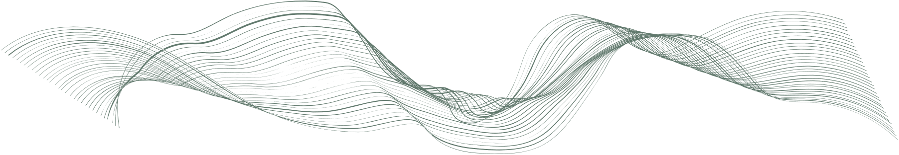
References
Support Vector Machines
k-Nearest Neighbors
Gradient Boosting
Scikit-learn: Machine Learning in Python, Pedregosa et al., JMLR 12, pp. 2825-2830, 2011.
Mitchell, Thomas M. “K-NEAREST NEIGHBOR LEARNING.” Machine Learning, McGraw-Hill, 1997, pp. 231–236.
“Gradient Boosting Machines.” Gradient Boosting Machines · UC Business Analytics R Programming Guide, uc-r.github.io/gbm_regression. Accessed 9 Nov. 2023.
PCA
Random Forest
Mean/Median Imputation
Brownlee, Jason. “How to Calculate Principal Component Analysis (PCA) from Scratch in Python.” MachineLearningMastery.Com, 9 Aug. 2019, machinelearningmastery.com/calculate-principal-component-analysis-scratch-python/.
“Random Forest: A Complete Guide for Machine Learning.” Built In, builtin.com/data-science/random-forest-algorithm. Accessed 6 Nov. 2023.
Zhang Z. Missing data imputation: focusing on single imputation. Ann Transl Med. 2016 Jan;4(1):9. doi: 10.3978/j.issn.2305-5839.2015.12.38. PMID: 26855945; PMCID: PMC4716933.

